Slide 1
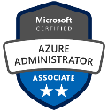
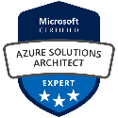
Windows Virtual Desktop Skilling Workshop – Section 2
Content by: Rich McBrine
Principal Cloud Solutions Architect
Microsoft, U.S. Education
rich.mcbrine@microsoft.com

Slide 2
The Case Study

Slide 3
Online University with Remote Access Needs
Students:
Non-Windows (Mac, Linux, iOS, Android) who do not want/need a full desktop
Some required apps only run on Windows
Global access required
Faculty & Staff
Univ. Admins who use the exact same Office apps every day
Seeking to reduce hardware maintenance overhead
Goal is to allow Admins to work from home on same desktop

Slide 4
Scenario – More Details
Client Situation | Design Considerations
Working w/client w/O365 already deployed - AAD in sync w/AD on-prem | We need to know if AAD Global Admin can help w/pre-reqs (allow WVD service to read AAD & assign Tenant Creator Roles
Client uses GPO’s to map drives to on-prem file servers | How fast is link to on-prem? What size files are being used by VMs in Azure? What will performance look like?
Client wants end-user experience that supports Roaming Profiles across WVD systems and Published Apps | FSLogix deployment to support Roaming between machines Different FSLogix Profiles for full Desktops and individual Apps File Server, Azure Files, or NetApp to host Profiles
Client has both Server and Windows 10 requirements in WVD | Licensing must be in place for each / they are different
Client wants cost estimates before moving forward | Cost calculator work to determine costs based on load
Client requires protocol encryption, does not want dependency on VPN for remote user access to VDI | Leverage existing WVD remote access constructs to meet this requirement without further work
VDI desktops must be attached to a customer managed private network | Need this info prior to any work / validate set aside for WVD

Slide 5
Scenario - More Details
Client Situation | Design Considerations
Client does not allow inbound FW exceptions into private network | Leverage existing WVD remote access constructs to meet this requirement without further work
Client owns M365 E5/A5 for employees (students if academic scenario) and wants to minimize cost wherever possible | Leverage licensing for Windows 10 multi-user access (fewer VMs to manage, stack multiple users per VM)
Client has Mac users who do not want full desktops | Need to use RemoteApp to publish specific Apps Need a list of those Apps, and plan to build FSLogix profile per App to support
Client has existing Windows users (full-time office admins) who do light-duty work in Office but need a full desktop / would like to save costs by providing a shared desktop solution | Need to use Remote Desktop in Windows 10 multi-user to lower costs Use Windows 10 multi-user to stack office admins on fewer VMs
Client has different internal Teams who want to build and manage their own WVD environments | Plan for multiple WVD Tenants / 1 per Team (hence Team layout for OpenHack) Grant rights to build WVD Tenants and Host Pools

Slide 6
WVD Tenant Planning

Slide 7
Build slide – Tenant Explanation
Windows Virtual Desktop tenant. Your Windows Virtual Desktop tenant is a management plane to manage host pools, app groups, users, and other related services that provide your users access to them
Windows Virtual Desktop tenant. Your Windows Virtual Desktop tenant is a management plane to manage host pools, app groups, users, and other related services that provide your users access to them
Windows Virtual Desktop session hosts. Windows Virtual Desktop session hosts are Azure virtual machines that can be grouped for identical session hosts into host pools. Each session host has a Windows Virtual Desktop host agent installed, which registers the virtual machine as part of your Windows Virtual Desktop tenant. And each host pool can have one or more app groups, which are collections of remote applications or desktop sessions that users can access. Windows Virtual Desktop Architecture Guide | 4 Azure virtual machines in a host pool can run one of several operating systems— including Windows 7 Enterprise, Windows 10 Enterprise, Windows 10 Enterprise Multisession, Windows Server 2012 R2 and above, including custom Windows system images with pre-loaded apps, group policies, or any other customizations. You also have your choice of virtual machine sizes, including GPU-enabled virtual machines.

Slide 8


WVD Tenant Relationships to Azure AD and Subscriptions
Client Subscription N
S2S Link
Client Subscription 1
Desktop Pool 1
Desktop Pool 1
Applications
AAD Connect
Applications
Desktop Pool 2
Active Directory or
Desktop Pool 2
Domain Services
Active Directory or
Domain Services
Virtual Network
Assign Tenant Creator Role to User(s) or Service Principal
Virtual Network
PaaS authorized to read AAD
Host Pool deployment places VMs in Subscription
Creates WVD Tenant(s)
Assigns Tenant Admin(s)
WVD PaaS Layer
Tenant Group
WVD Tenant 1
Host Pool Config
WVD-specific metadata
WVD RBAC
Web Access
Diagnostics
WVD Tenant N…
Host Pool Config
WVD-specific metadata
WVD RBAC
Gateway
Broker
Azure SQL DB
Creates Host Pools
Grants User Access to Host Pools
Create Host Pool
Create Host Pool
Create Host Pool

Slide 9
LAB WORK: Create a WVD Tenant

Slide 10
Steps to Prep the Student PS1 file
Everyone on your team must Change Lines 22-33 to the same thing:
$SubGUID = "InsertYourSubscriptionGUIDHere"
$SubGUID
$AADGUID = "INSERTYOURAADGUIDHERE"
$AADGUID
$WVDTenantName = "ReplaceWithDesiredNameofWVDTenant"
$WVDTenantName
$HostPoolNameDesktops = "ReplaceWithDesiredNameofDesktopHostpool"
$HostPoolNameDesktops
$HostPoolNameApps = "ReplaceWithDesiredNameofAppsHostpool"
$HostPoolNameApps
$AppGroupName = "ReplaceWithDesiredNameofAppGroup"
$AppGroupName
“Insert” means Copy/Paste the GUIDs from Azure AD and the Azure Subscription we’ll use today
“Replace with” means you have to invent names for the workshop
Everyone needs to update the PS1 file running in their copy of Windows PowerShell ISE
No spaces, no special characters, keep to alphanumeric characters only
Example:
From: $WVDTenantName = " ReplaceWithDesiredNameofWVDTenant "
To: $WVDTenantName = “MyWickedGoodTenant"

Slide 11
Steps to Create a WVD Tenant (follow me)
UserA on each Team will do this / 1 WVD Tenant per Team
User A:
Select and then Run lines 22-33 (all code in Variable Definition Section)
Run line 53 to create your Team’s WVD Tenant:
New-RdsTenant -Name $WVDTenantName -AadTenantId $AADGUID -AzureSubscriptionId $SubGUID
Use line 56 to validate your Team’s WVD Tenant:
Get-RdsTenant $WVDTenantName
Add the other UPN’s from your Team to the Tenant (line 59)
Change the UPN for –SignInName for each user
Also add these UPNs: remadmin@hackwvd.net ricks@hackwvd.net mortys@hackwvd.net
All other users: Run Line 63 and validate you can enumerate the Tenant

Slide 12
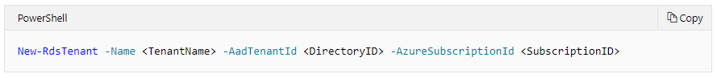
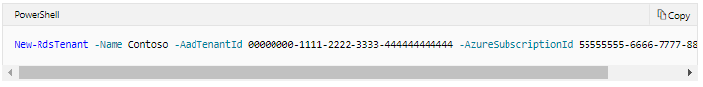
For Reference Only - Create WVD Tenant
Run PowerShell ISE as Administrator
Set-ExecutionPolicy Unrestricted
# Install / Update core Azure RM Modules regularly:
Install-Module -AllowClobber -Force AzureRM
Install-Module -AllowClobber -Force -Name Microsoft.RDInfra.RDPowerShell
Run one command to create a WVD Tenant:
AAD Tenant ID obtained from AAD Global Admin
Subscription ID from Azure Portal

Slide 13
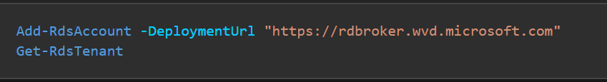
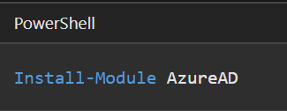
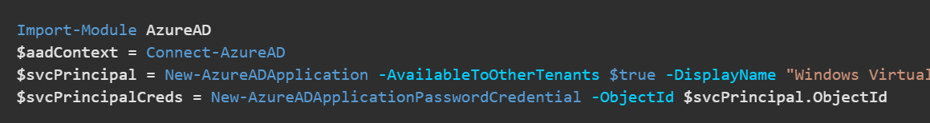
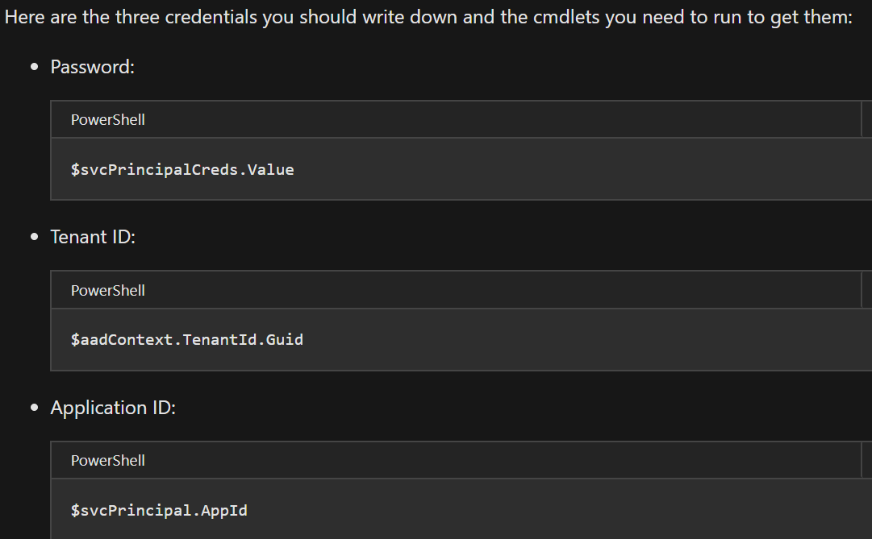
Wait, what about Service Principals?
When should I use a Service Principal with WVD?
Automate specific Windows Virtual Desktop management tasks such as host pool creation, authorizing users, setting host pool parameters, etc.
Use as credentials in place of MFA-required users when running any Azure Resource Manager template for Windows Virtual Desktop.
OK, what are the steps?
Create a service principal in Azure Active Directory.
Create a role assignment in Windows Virtual Desktop.
Sign in to Windows Virtual Desktop by using the service principal.
It’s all documented here - https://docs.microsoft.com/en-us/azure/virtual-desktop/virtual-desktop-fall-2019/create-service-principal-role-powershell

Slide 14
Host Pool Planning

Slide 15
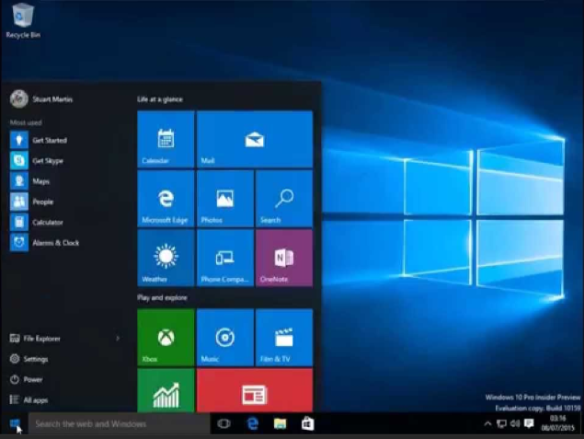
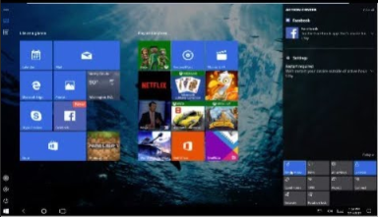


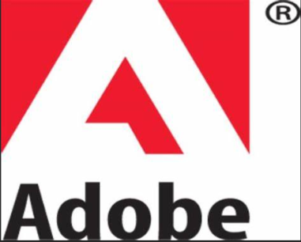
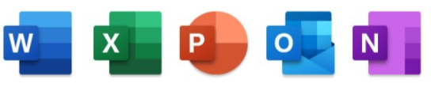
Host Pools
Desktop Host Pool
Consist of a group of VMs that offer either Desktops or Apps
Must be kept consistent / patched to same level
Do not all have to be online all the time
All built from the same Image at Host Pool creation
Individual VMs in Host Pools are “seen” by the Broker service (next slide)
Broker service mediates access to the “best available” VM in the Host Pool
Published Desktops
Published
apps
Apps Host Pool

Slide 16




Windows Virtual Desktop – Broker Interactions w/Host Pools
0. WVD Agent on Domain-Joined Host VMs connects to Broker
1. User launches browser, connects to Azure AD, user signs in, and Azure AD returns token
2. Client presents token to Web Access, Broker queries DB to determine resources authorized for user
3. User selects resource, is connected to Gateway by the Azure service
4. Broker orchestrates connection from Host Agent to Gateway
>>> RDP traffic now flowing between RD client and session host VM between 3 and 4
RD clients
Customer-managed
Windows Virtual Desktop Microsoft-managed Azure PaaS
Windows 10 Enterprise multi-session
Customer-managed Azure VMs & services
1
Azure AD
VMs
2
Web Access
Diagnostics
4
Desktops in Host Pools
A
Apps in Host Pools
A
FIREWALL
FIREWALL
0
3
Gateway
Broker
Active
Directory
User Profile
File Server
Azure SQL DB

Slide 17
All VMs in WVD must access Management Plane
Ports Reference: https://docs.microsoft.com/en-us/azure/virtual-desktop/overview
Forced Routing Reference for KMS traffic: https://docs.microsoft.com/en-us/azure/virtual-machines/troubleshooting/custom-routes-enable-kms-activation
Address | Outbound port | Purpose
*.wvd.microsoft.com | TCP port 443 | Service traffic
*.blob.core.windows.net | TCP port 443 | Agent, SXS stack updates, and Agent traffic
*.core.windows.net | TCP port 443 | Agent traffic
*.servicebus.windows.net | TCP port 443 | Agent traffic
prod.warmpath.msftcloudes.com | TCP port 443 | Agent traffic
catalogartifact.azureedge.net | TCP port 443 | Azure Marketplace
kms.core.windows.net | TCP port 1688 | Windows 10 activation

Slide 18
Planning FSLogix, OU’s, and GPO’s for Each Host Pool

Slide 19

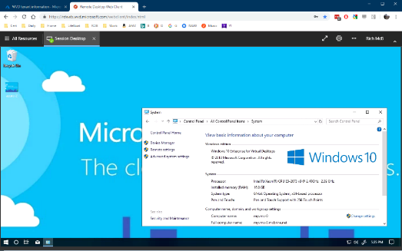
Why Roaming Profiles Are Cool
Profile Loads from Server at Logon, Profile Writes to Server at Logoff
Profile File Server
VM1
Profile Loads from Server at Logon, Profile Writes to Server at Logoff
My Settings Follow Me
I can login to any VM and my look & feel is the same
Easy to set up and administratively configure
Files and cached data retained
VM2

Slide 20
Why Roaming Profiles Have Issues
The more I have in my profile, the longer logon/logoff takes
Profile File Server
Large roaming profiles take a long time to download & upload, extending logon & logoff times
5% of customers surveyed by ControlUp in 2017 recorded logon times of >1 minute
Majority of respondents (57%) indicated <25 second logon times / Logon times of over 10 minutes are not unheard of
Users can force this problem inadvertently (e.g., copying a large ISO file to their desktop and then logging off)
Roaming profiles need to be uploaded at logoff
If interrupted the profile is often left in a corrupt state (impatient user hard powers off laptop)
When this happens, empty temporary profile is created; IT intervention needed to resolve
Entire Desktop is locked until entire Profile is done loading/unloading
“Profile Bloat” on C: drive of Host VM – each User’s files remain on the VM (C: drive will run out of space)

Slide 21
Why FSLogix is better
Profile network-attached at Logon, Profile detached at Logoff
Profile File Server
VM1
Profile network-attached at Logon, Profile detached at Logoff
Large roaming profiles are not downloaded or uploaded, instead are network-attached
User sees a single C drive / seamless integration
No waiting period; roaming profiles components are not copied at logoff/logon
Office cache (Outlook, OneDrive, etc.) is centralized; FSLogix agent on host links as-needed
No “Profile Bloat” on C: drive of local system
VM2

Slide 22
BUT….

Slide 23
FSLogix Profiles are not Defined The Way You May Think
A given FSLogix Profile disk is assigned to a given Desktop or App
Once a Desktop or App mounts assigned FSLogix Profile Disk, it’s locked
No subsequent mounting to another App or Desktop from another HostPool
Best approach is “Microprofiles”
For each App HostPool
For each published Desktop HostPool

Slide 24
Consider….
Until we get concurrent FSLogix…
1:1 Host Pool to FSLogix Profile mapping
Roaming of FSL profile will only work for first login VM; 2nd is locked out
Same applies to Published App Host Pools
FSLogix Profile Disk Locks on File System
X
User Logs into WVD VM Full Desktop
User THEN Logs into 2nd WVD VM Full Desktop
Roaming settings didn’t work/ didn’t follow me
Cached work / config has to start all over (w/LOCAL profile)
Roaming settings work/followed me
Cached work / config where I left it

Slide 25


FSLogix Profile per HostPool
\\FSLFS\Share\Apps2
Published
apps
Apps2 Host Pool
Desktop1 Host Pool
\\FSLFS\Share\Desktop1
Best Practices:
Unique UNC for each HostPool
Name directory same as HostPool (easy to see mapping)
Published Desktops

Slide 26
Naming Conventions – A Starting Idea
First Letter indicates Dev, Test, Staging, or Prd
Second letter indicates App or Desktop Pool
Third letter indicates Purpose (e.g. "F" for Faculty, "S" for Students, etc.)
Fourth & fifth numbers indicate what apps are in the Image (list kept in change control); examples:
01: No Office, 3 custom apps
02: Office 365, 2 custom apps
03: Office 365, 8 other custom apps
Sixth, Seventh, and Eighth numbers indicate the day of the year, 001-365
So PAF05086 means it's a Production HostPool deploying Apps, targeted for Faculty using app package 05 deployed on Day 086 of the year

Slide 27
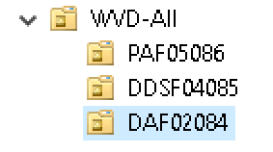

Deploy Common Names across OU’s, GPO’s, Resource Groups, HostPools & VM Names in AD
Create an OU Structure
Naming convention is OU, HostPool, Share, and VM Name all match
3. Create GPO’s for each OU w/the same name
4. GPO points to FSL Profile share w/same name
5. Create a HostPool of the same name that populates the OU
a. Deploy to Resource Group of the same name PAF05086
6. Name VMs with same name
VM NetBIOS names are PAF05086-0, -1, etc.
\\FSLFS\Share\PAF05086
PAF05086 Host Pool
Block Inheritance Here
Name is consistent across all components – easy to see which parts are related

Slide 28
Deploy FSLogix File Server

Slide 29
Profile IOPS Planning Guidance
IOPS impacts on a VM are:
1.5-3 IOPS per App Pool
3-8 IOPS per Desktop pool
Logon/logoff will multiply each number between 5x and 10x IOPS
This is a planning estimate w/o knowing anything about workloads

Slide 30
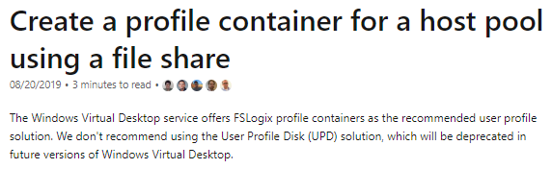
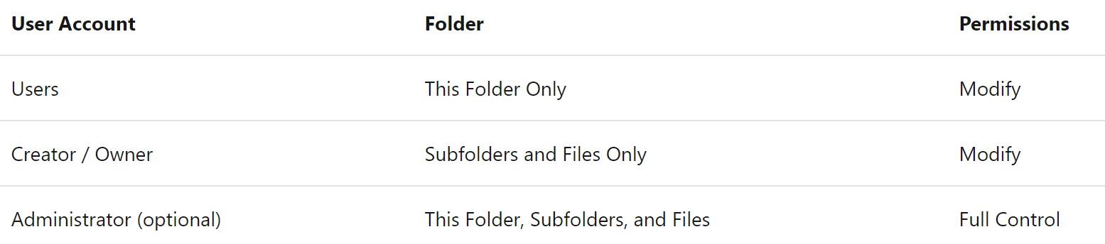
Follow MS.com Documentation – Create File Shares
https://docs.microsoft.com/en-us/azure/virtual-desktop/create-host-pools-user-profile
Important steps:
Set security per: https://docs.microsoft.com/en-us/fslogix/fslogix-storage-config-ht
Create Sub-folders for each HostPool
Match name to chosen HostPool names for easy referral afterwards
Ensure Antivirus software on FSLogix Profile Servers is not scanning the VHD(x) files hosted for end-users (set relevant exclusions)

Slide 31
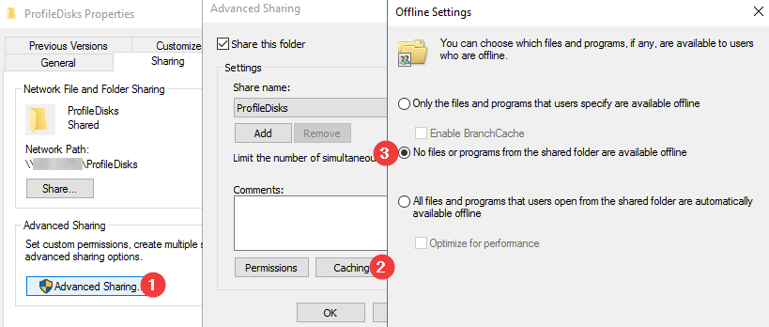
Config of File Server Shares for FSLogix
Network Location of Server:
To reduce latency and the likelihood of a UPD disconnect the server hosting the UPD share should be on the same VNet as the HostPool systems
Use ReFS for the UPD drive:
Using ReFS as the file system of the drive that will host the UPDs will improve VHDX performance
This will be evident when creating UPDs (first login) and when they need to expand
AV Exclusions:
Make sure to exclude VHDX files from your AV, and make sure that they actually show up on the client's exclude list
Note: simply excluding *.vhdx files from some A/V does not do the trick; you may have to create these exclusions:
\\SERVER\*.vhdx (File Server)
\\EXAMPLE.COM\*.VHDX (DFS namespace) (you only need this if you're deploying FSLogix)
L:\*.vhdx (Local drive on the file server)
Compact your UPDs:
UPDs set to dynamic VHD(X) files via Policy can expand up to 20GB by default
The UPD automatically expands any time the user adds data to it, but it never compacts once data is removed - you may end up with a ton of blank used space
Customize this script & run as a scheduled task on your file server; it will go through your UPD share and compact any VHDX files that are not in use
Disable Share Caching:
Disabling share caching can prevent some rare situations where the UPD fails to dismount from the RDS server
It also has no negative effects since there is no need to cache the UPD files
Go to the Caching Settings of the profile disk share and select "No files or programs from the shared folder are available offline"

Slide 32
Create Folders for Each HostPool
Each host pool is assigned a unique share/profile so that concurrent connections to the profile do not occur
\\FSLFS\Share\Apps2
Published
apps
Apps2 Host Pool
Desktop1 Host Pool
\\FSLFS\Share\Desktop1
Best Practices:
Unique UNC for each HostPool
Name directory same as HostPool (easy to see mapping)
Published Desktops

Slide 33
Configure FSLogix GPOs

Slide 34
Import ADMX/ADML
Copy to Central Store (NOT “Local GPEDIT option):
https://docs.microsoft.com/en-us/fslogix/use-group-policy-templates-ht
If Folders do not exist:
https://support.microsoft.com/en-us/help/3087759/how-to-create-and-manage-the-central-store-for-group-policy-administra

Slide 35
Allow Office Activation to Roam w/User
Reference: https://docs.microsoft.com/en-us/DeployOffice/overview-of-shared-computer-activation-for-office-365-proplus
Users can activate Office 365 ProPlus only on a limited number of devices, such as 5 PCs.
Gallery Multi-User Win10 Images in Azure w/O365 ship with Shared Computer Activation (SCA) - doesn't count against that limit
Alternatively, you can “clean” install O365 and enable SCA
3 steps required to enable Office Activation to roam:
Note that the O365 Container is separate from the Profile Container
In O365 Containers node, change “Enabled” key from “Not Configured” to “Enabled”
Enable “VHD Location” key and provide a path to a file share on FSLogix Server
Set “Include Office activation data in the container” to Enabled

Slide 36
Customize A Gold Image for WVD

Slide 37
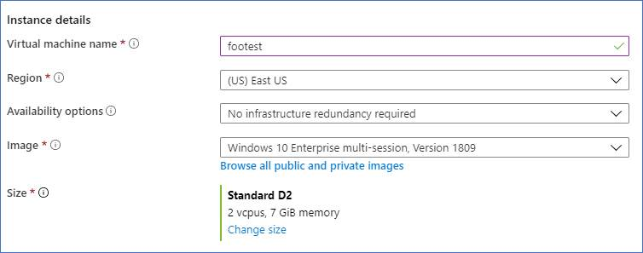
Build a VM from Scratch – Choose the Correct OS
Create a VM from a managed image
Build the VM like you would any other (we’re not creating anything WVD-centric at this point, just a VM to customize)
Region is the same as where you are deploying WVD HostPools, Subnets in same Region
Ensure this is the version showing
Browse to find it….

Slide 38
Customize the VM
Login to the VM you just created and configure it how you like
Guides:
Software preparation and installation – MS Guidance
https://www.robinhobo.com/how-to-create-a-custom-windows-10-multi-user-image-with-lob-applications-for-windows-virtual-desktop-preview-wvd-hostpool-deployments/ (3rd party, but great!)
Key configs:
VERY important to get Office & OneDrive deployed per-machine
Install OneDrive in per-machine mode
Install Office in shared computer activation mode
VERY important to register VM with Azure-based KMS
Code: Invoke-Expression "$env:windir\system32\cscript.exe $env:windir\system32\slmgr.vbs /skms kms.core.windows.net:1688"
DO NOT EVER activate manually w/any typed-in License Key (it will change VM forever to single-user)
Do all MS Updates for OS and Office (Toggle Windows Update >> Advanced Options: “Receive updates for other Microsoft Products…”)
Popular Add-Ons:
FSLogix agent so persistent user experience across VMs
WVD Full client to put Remote Apps in the Start Menu
Institutional antivirus
Management / monitoring tools
Sepago Agent for monitoring VMs

Slide 39
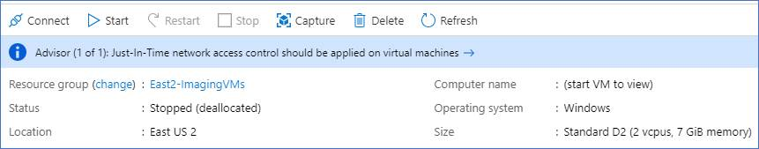
Turn the VM Into an Azure Image
Once done with customization:
Sysprep the system and shut it down
Verify in the Azure console VM is “Stopped (deallocated)”
Ref: https://docs.microsoft.com/en-us/azure/virtual-machines/windows/capture-image-resource
After VM shut down select “Capture” on the VM’s management page:

Slide 40
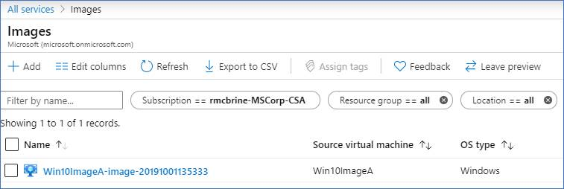
Image Completed
Validate Image showing in the “Images” node in Azure

Slide 41
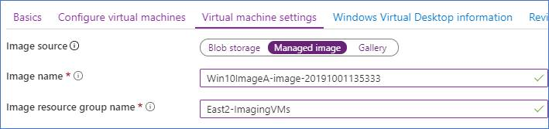
We will Use The Image for WVD Systems
Later, we will follow the normal steps of Host Pool creation
When you get to “Virtual Machine Settings” tab:
Pick “Managed Image”
Fill in the metadata about the Image you’ve created:

Slide 42
Deploy Desktop and App Host Pools using Gold Image

Slide 43
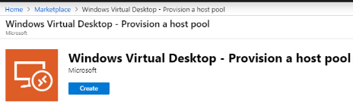
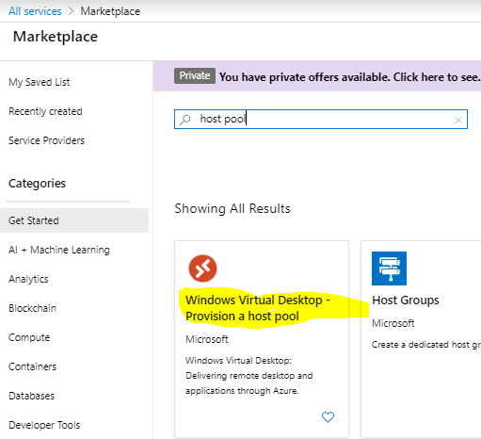
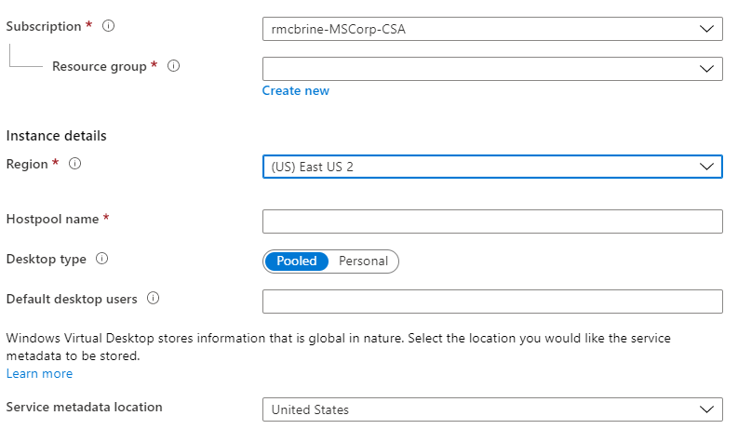
Create Host Pool - Basics
Ensure Correct Sub is Showing
Choose or create Proper RG
Ensure Correct Azure Region is Selected
Insert Name of HostPool – same one you specified in PS1 Variables
Fill in UPNs for Full Desktop HostPools – leave blank for App HostPools

Slide 44
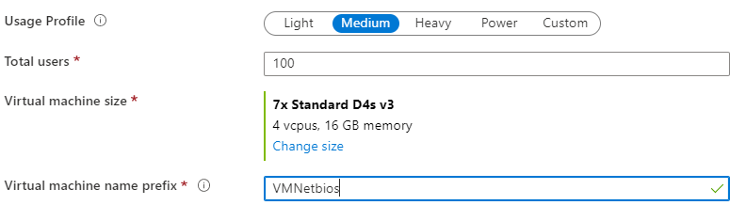
Create Host Pool - Configure virtual machines
Change to 20 for POC Purposes
Should change to 2 VMs here; can change to VMs to GPU-enabled if needed
AD Name for VMs – will be appended with -0, -1, -2, etc…

Slide 45
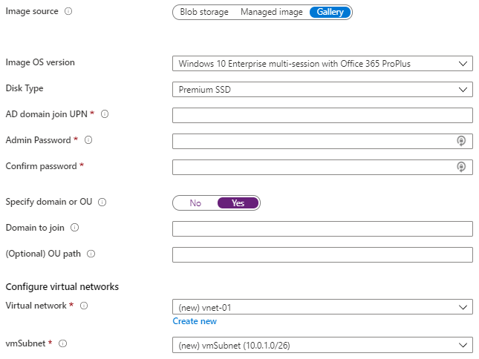
Create Host Pool - Virtual machine settings
Option 1: Using a Non-Customized, Gallery Image
Leave Default as-is
Ensure this is the version showing
UPN for Domain Join Account
Pwd for Domain Join Account
Pwd for Domain Join Account
Change to Yes
Fqdn of AD domain NOT NetBios name (e.g. onpremad.client.edu)
Distinguished name of OU (e.g. OU=Users,OU=Company_1OU,DC=Company_1,DC=internal)
Select VNet used for POC
Select Subnet used for POC

Slide 46
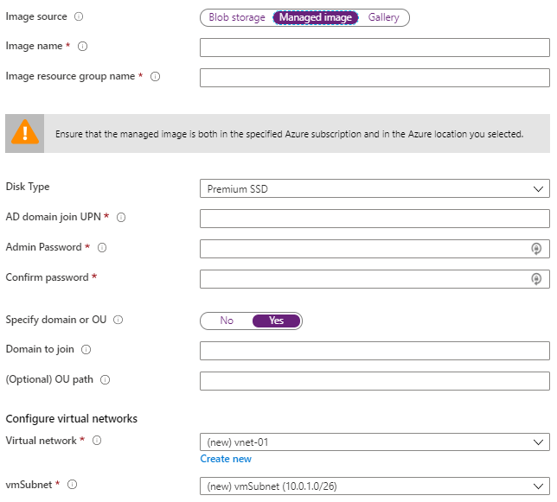
Create Host Pool - Virtual machine settings
Option 2: Using a Customized, Managed Image
Change to Managed Image
Paste Image Name shown on Images Node
Paste Image RG shown on Images Node
UPN for Domain Join Account
Pwd for Domain Join Account
Pwd for Domain Join Account
Change to Yes
Fqdn of AD NOT NetBios name (e.g. onpremad.client.edu)
DN of OU (e.g. OU=Users,OU=Company_1OU,DC=Company_1,DC=internal)
Select VNet used for POC
Select Subnet used for POC

Slide 47
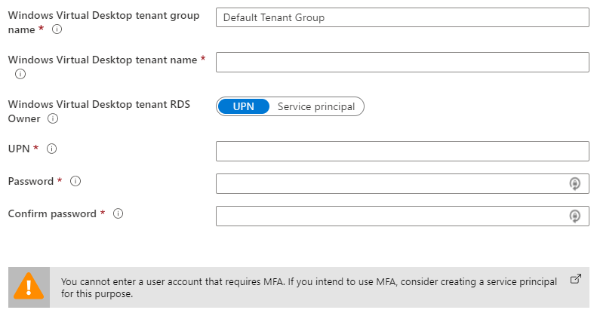
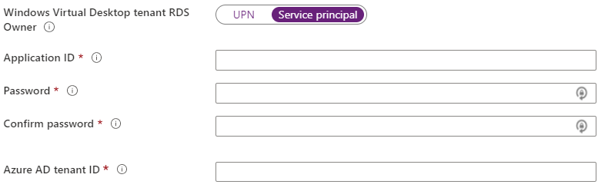
Create Host Pool - Windows Virtual Desktop information
Do NOT Change
Name of WVD Tenant Created Previously
Toggle depending on which we are using in the POC/Lab
Fill in relevant info for either solution

Slide 48
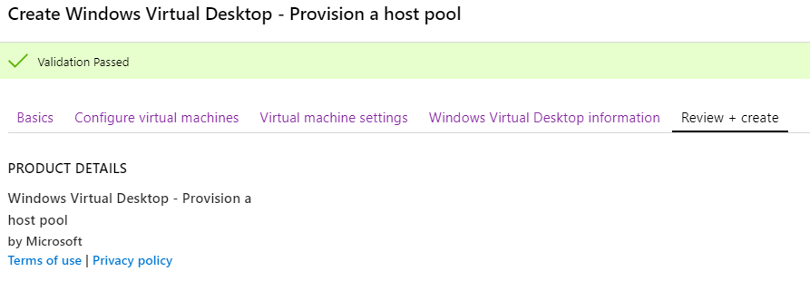
Create Host Pool - Validation & Create Step

Slide 49






Azure Bastion
Customer’s Virtual Network
Private IP
Secure and seamless RDP and SSH access to virtual machines – Leverage this for direct VM Login (bypasses WVD PaaS layer)
Port: 3389/22
“AzureBastionSubnet”
Azure VM
SSL
GA
Remote Protocol
(RDP, SSH, et al)
RDP/SSH to your VMs using HTML5 standards-based web-browser, directly in Azure Portal
Resources can be accessed without public IP addresses
Supported Azure resources include VMs, VM Scale Sets, Dev-Test Labs
Azure VM
Azure Portal
SSL
443, Internet
Azure VM
Azure Bastion
AzureBastionSubnet
Target VM Subnet(s)

Slide 50
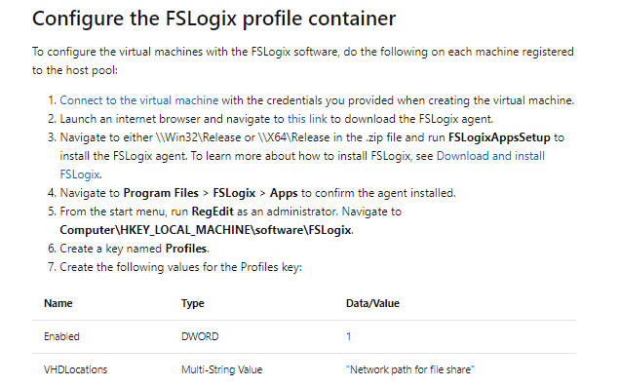
Add FSLogix Regedits to Host Pool Systems
https://docs.microsoft.com/en-us/azure/virtual-desktop/create-host-pools-user-profile
Once created, RDP to each VM directly using Bastion Host (previous slide)
Install x64 version of FSLogixAppsSetup.exe if needed
Edit Registry Entries shown
“Enabled” turns on FSLogix agent (you may have to manually install FSL if non-customized VM)
VHDLocations points to UNC of WVD Profiles for this specific VM
Next slide: Best Practices
Reboot the VM

Slide 51
FSLogix Profile per HostPool
\\FSLFS\Share\Apps2
Published
apps
Apps2 Host Pool
Desktop1 Host Pool
\\FSLFS\Share\Desktop1
Best Practices:
Unique UNC for each HostPool
Name directory same as HostPool (easy to see mapping)
Published Desktops

Slide 52
Next Steps
If you created a Desktop HostPool:
Login to one of the VMs via WVD at: https://aka.ms/wvdweb
Use creds for one of the assigned Desktop Users
Optionally add more users per the PS1 (line 74 Add-RdsAppGroupUser… )
If you created a RemoteApp HostPool:
Follow steps to Publish Apps in the PS1 (lines 97-125 starting at # 2. Create a new RemoteApp app group)
Assign Users to the Published Apps Pool (line 128 Add-RdsAppGroupUser…)
Login to show the apps WVD at: https://aka.ms/wvdweb
Use creds for one of the assigned RemoteApp Users

Slide 53
Follow-on Topics

Slide 54
Resources – Getting Started
Required Reading: Getting started with Windows Virtual Desktop
PG Sessions and Summary Guidance:
All you need to know about Windows Virtual Desktop | On Demand
Webcast resource guide: All you need to know about Windows Virtual Desktop
YouTube sessions:
Azure Academy Virtual Desktop Series
Optimizing your applications for Windows Virtual Desktop
Azure Windows Virtual Desktop Public Preview Walkthrough
Azure Windows Virtual Desktop FSLogix Profile Management Walkthrough
Online Tutorials:
Tutorial: Create a tenant in Windows Virtual Desktop Preview
Tutorial: Create service principals and role assignments with PowerShell
Tutorial: Create a host pool with Azure Marketplace
Tutorial: Manage app groups for Windows Virtual Desktop Preview

Slide 55
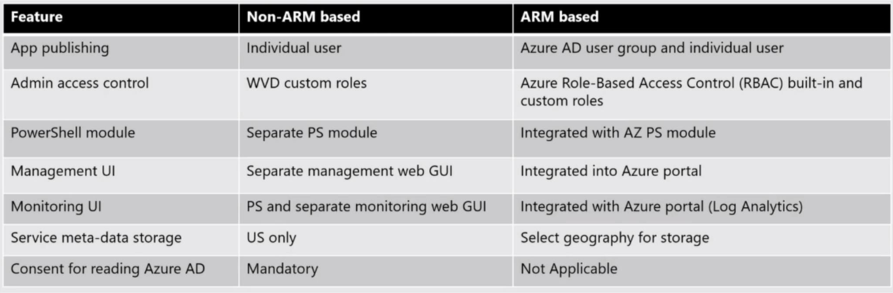
WVD V2 Is In Preview… (May 2020)
Windows Virtual Desktop Spring Update enters Public Preview
https://www.christiaanbrinkhoff.com/2020/05/01/windows-virtual-desktop-technical-2020-spring-update-arm-based-model-deployment-walkthrough/

Slide 56
Thank You!!

